Slide 1
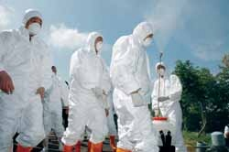
Lesson 3
Epidemics Explained
Module 7 Unit 21 1st period
Cheng Huiyun

Slide 2
Objectives
At the end of the lesson, you are expected to be able to:
identify the structure of one type of discursive essays.
use the strategies of sequencing to put the text back together.
complete the sentences in Ex.4 in your own words.
voice your feelings about epidemics.
arranging events in order

Slide 3
Which of the following diseases is epidemic adj. ?
AIDS，cancer, flu, Bird Flu,
Hand-feet-Mouth Disease, heart disease
headache, backache, toothache, stomachache
TB = Tuberculosis 肺结核

Slide 4
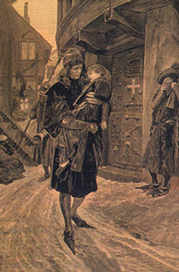
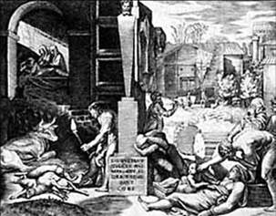
Death silently leapt from house to house,
Till he nearly lost his prey (被掠食者 ).
--Francis Macnamara British
People dropped dead like flies (苍蝇).
Grief-stricken mothers mourned their sons’ death,
Till their tears ran dry.
Unfortunately, they are all bloody truth.
(P. 38) 2 Work in pairs. Do you think these statements are true (T) or false (F)?
Flu kills millions of people every year.
2) Most diseases are very new.
3) Epidemics have affected historical events.
4) It takes years for a disease to spread worldwide.
5) Epidemics can wipe out up to half of the population in urban areas.
6) More people died of a flu epidemic in 1918/1919 than died in World War I.
kill, destroy
in a town or city

Slide 5



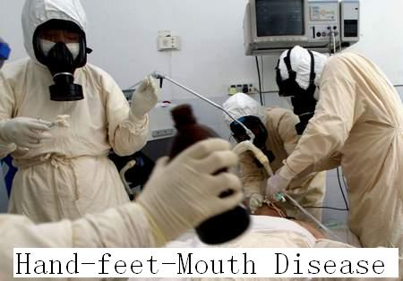
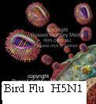
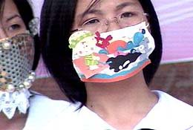
Dr Garcia
no matter how good modern science is, a future epidemic is inevitable.

Slide 6
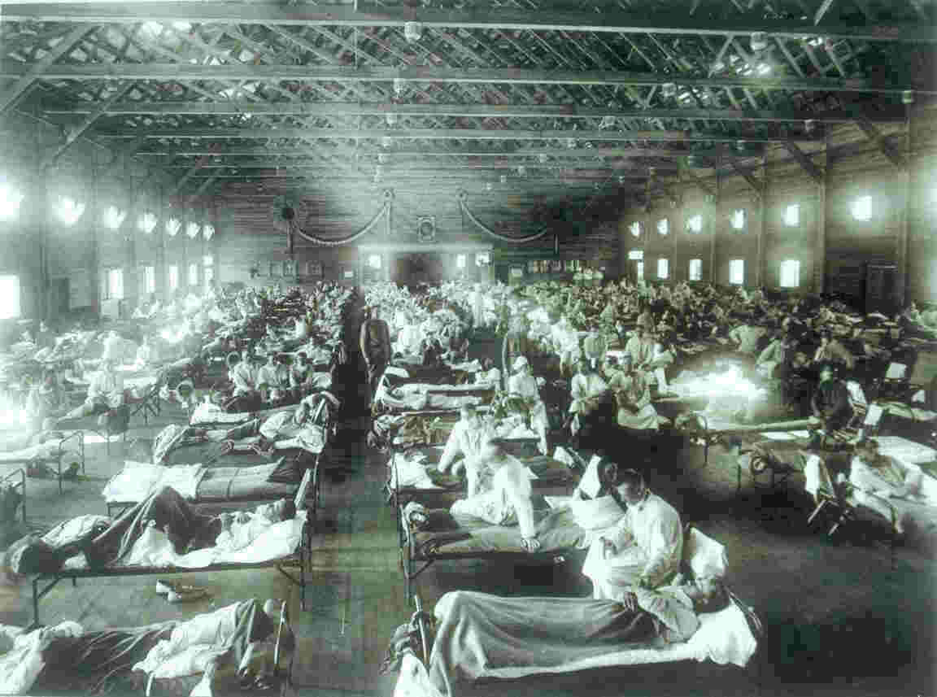
Epidemics
throughout history

Slide 7
What does the writer tell us in the background introduction?
With recent press reports drawing parallels between Bird Flue and a killer epidemic in the past, Jim Smith looks through the history of epidemics for clues about what the future might hold.
draw parallels
A. to draw the sign “=”
B. to show two different things are similar
Bird Flu is similar to a killer epidemic
in history.
A scientist looks through the history of epidemics
to find clues for the Bird Flu.
hold clues for Bird Flu
B

Slide 8
Read the first two paragraphs and find out why scientists look through the history of epidemics.
They want ________.
to find out how epidemics have happened
to predict and prevent epidemics in the future
to see how bacteria and viruses have been affected human life
to see what the future of the world will be like
Statement:
The Bird Flu is a modern adaptation
of the Spanish Flu.
Problem:
how to foresee and prevent it?

Slide 9

Read the last paragraph and see if the essay writer presents a solution? If he does, what is it?
Yes, he does.
Countries will need to work together to find a cure for Bird Flu as soon as possible.
We have to have faith that there will be solutions in time to stop a bird Flu epidemic in its tracks.

Slide 10
How does he support his solution?
By analysing the epidemics in history.
The structure of this discursive essay
1. Statement: Bird Flu=Spanish Flu
2. Problem: How to foresee and prevent it
3. An analysis of the problem
4. Solution: joint effort & faith

Slide 11
Please put the text back together.
Tips:
Follow the timeline.
Read the sentences before and after the gaps.

Slide 12
Match the five paragraphs
A
B
C
D
E
Paragraph 3
Paragraph 5
Paragraph 8
Paragraph 10
Paragraph 12

Slide 13
What are the historical epidemics studied?
Justinian Plague, the Black Death,
the Spanish Flu, the SARS
Read for the missing information and fill out the form. Put down the key words only.

Slide 14
Epidemics | Time | Place | Causes or Effects
Bird Flu H5N1 | 1997— | worldwide,
Justinian Plague (贾斯廷瘟疫 ) Bubonic plague | 500-550AD | North Africa, the Middle East, Europe
the Black Death (Bubonic plague) 鼠疫 |  | Asia, Europe, Africa, the Middle East
empire , emperor, empress
take ﹥100 lives
50%, Roman Empire
habit
war, crowded cities, lack, health routines 50% be lost to
1348-
1350

Slide 15

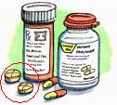
Epidemics | Time | Place | Causes or Effects
 | 1918 | similar as the Black Death
SARS |  | China , Canada, Vietnam, Singapore Hong Kong,---
The Great Flu Epidemic
(The Spanish Flu)
50 million, 18 months, the young and fit
tablets
new, doctors, no prescription, 9 months, 774, 8,000
2002/2003

Slide 16
Read aloud after the tape
Complete these sentences about the text in your own words. (Pair work Ex.4)
1. We know that epidemics have been with us for thousands of years because ...
Bacteria and viruses have been around since the beginning of life on Earth and many of today’s diseases have existed as long as humans have. | The earliest epidemics on record happened around 500-550 AD.
Which is the reason? Why?

Slide 17
Possible version
… it was recorded that the earliest epidemics occurred about 500-550 AD so that we are sure that bacteria and viruses had existed on earth long before that. Based on this knowledge, we can speculate that epidemics have been with us for long. As a matter of fact, many of today’s diseases are as old as humans.

Slide 18
Are they convincing enough to support the solution?
Alarming facts
epidemic – consequences
500—550AD Justinian Plague —50% killed —the
Roman Empire, North Africa, the Middle East,
Europe
500—550AD Justinian Plague — up to 50% of the population were killed — the down fall of the Roman Empire
Countries will need to work together to find
a cure for Bird Flu as soon as possible.
With the international effort being made,
we have to have faith that there will
be solutions in time to stop a Bird Flu
epidemic in its tracks.
1930’s, the Black Death —50% lost to. Asia, Europe,
Africa, the Middle East
1918, Spanish Flu, 50 million killed
18 months, Asia, Europe, Africa, the Middle East
2002—SARS –9 months –8,000 –774 Asia,
Europe, Africa, the Middle East
1997—Bird Flu –more than 100 lives, Asia,
America– future ?

Slide 19
Latest breakthrough！
Bird flu vaccine successful
Scientists at the University of Hong Kong (HKU) and the US have developed an experimental H5N1 Bird Flu vaccine for people. Initial tests on mice showed the vaccine to be highly effective and the speed of antibody response was high.

Slide 20
Share your feelings with your partner
1.How did you feel after reading the article?
(Can science solve all the problems?
How can you contribute to it?
or … )
Our oath
Stop epidemics in their tracks.

Slide 21
The structure of this discursive essay
1. Statement: Bird Flu=Spanish Flu
2. Problem: How to foresee and prevent it
3. An analysis of the problem
Justinian Plague, Black Death, Spanish Flu, SARS
4. Solution: joint effort & faith

Slide 22
Homework
Page 86 Focus on reading
Analyse the reading material
Statement?
Problem?
Analysis of the problem (mention the aspects only)
Solution

Slide 23
Language points

Slide 24
impulse (u) n. 冲动，心血来潮
have an impulse to do 有做…的冲动
on impulse 过激地
impulse shopping 冲动购物
Shun De food is tasty and you may want to try it immediately.
___________________________________
___________________________________
Shun De food is tasty and you may have an impulse to try it immediately.

Slide 25
interpret vt.
interpret for sb. 为…做口译
interpret sth. as sth. 把…理解成…
sth.is interpreted as … …被理解为…
e.g. I didn’t know whether to interpret her silence as acceptance or refusal.
我不知道该把她的沉默看作是接收还是拒绝。

Slide 26
Fo Shan has a long history so it has many traditional buildings like the Ancestral Temple.
____________________________________________________________________________________________________________
Many traditional buildings like the Ancestral Temple can interpret the long history of Fo Shan.

Slide 27
identify vt. 确定；认出；识别
identify sb./sth. 认出
identify sb./sth. as sb./sth. 认出…是…
It is easy to identify… 容易识别出…
e.g. He identified the two bodies as those of two suspected drug dealers.
他认出那两具尸体是两名毒贩嫌疑人的。
identification
identity
n. 身份证明
n. 特征

Slide 28
postpone vt. 推迟，延期
postpone sth. until some time
=delay=put off
a delay of two hours 延误了2个小时
prohibit vt. 禁止
prohibit (sb.’s) doing sth.
prohibit sb. from doing sth.
=forbid-forbad(e)-forbidden
=ban-banned-banned

Slide 29
bring up
e.g. He brought up a practical plan in the meeting, which brought down the cost of production
e.g. His parents died when he was born and he was brought up by his uncle.
e.g. He was drunk and brought up what he had eaten at midnight.
提出
养育；抚养
呕吐

Slide 30

Thank you

